Slide 1
Input Device: Scanner (3D)
CSE 315
Peripherals & Interfacing

Slide 2







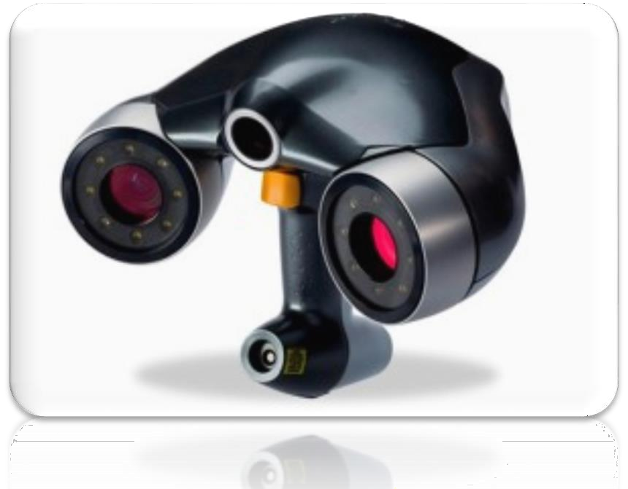
Scanner : 3D
A 2D scanner with Z dimension
It is able to analyze a real world object in all the (X, Y, Z) dimensions
This type of scanner is specially used in entertaining industries (movie & gaming)

Slide 3






3D Scanner : Functionality
To create a point cloud of geometry samples
These points are then used to redraw the object
As like as camera, a 3D scanner can only collect information of an object that is obscured

Slide 4











3D Scanner : Classification
Depending on the technology
Contact 3D Scanner
Non-contact 3D Scanner
Non-contact Active
Non-contact Passive

Slide 5




















3D Scanner : Contact
Scan through physical touch
This is basically a scanner with CNC (Computer
Numerical Control)
There is a mechanical system available that holds the scan unit
This system can move in any direction
E.g. Co-ordinate Measuring Machine (CMM)

Slide 6



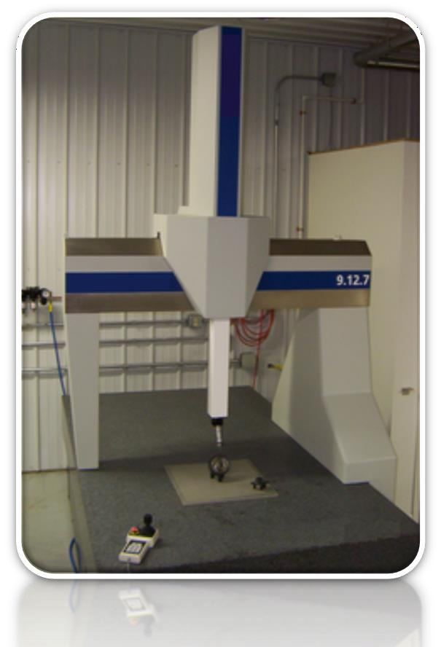
3D Scanner : Contact
Contact 3D Scanner is used in manufacturing industries
Cons: Need physical contact

Slide 7






3D Scanner : Non Contact
This type of scanner do not need any contact with the target object
Instead of Physical contact, radiation is used
Radiation could be LASER, IR or VR
Depending on the radiation these are
Active (NCA): Uses external light resource
Passive (NCP): Uses the reflected light

Slide 8













3D Scanner : NCA & NCP
Name of some NCA
Time-of-flight: Uses LASER
Triangulation: Uses LASER
Conoscopic Holography: Uses LASER
Hand held: Uses LASER
Structured light: Uses VL
Modulated light: Uses VL
Volumetric: Uses X-Ray
NCP uses reflected light from the target object

Slide 9
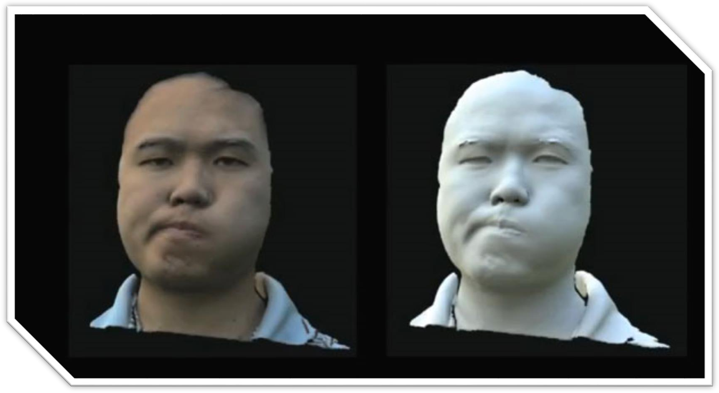
3D Scanner : Screenshot

Slide 10
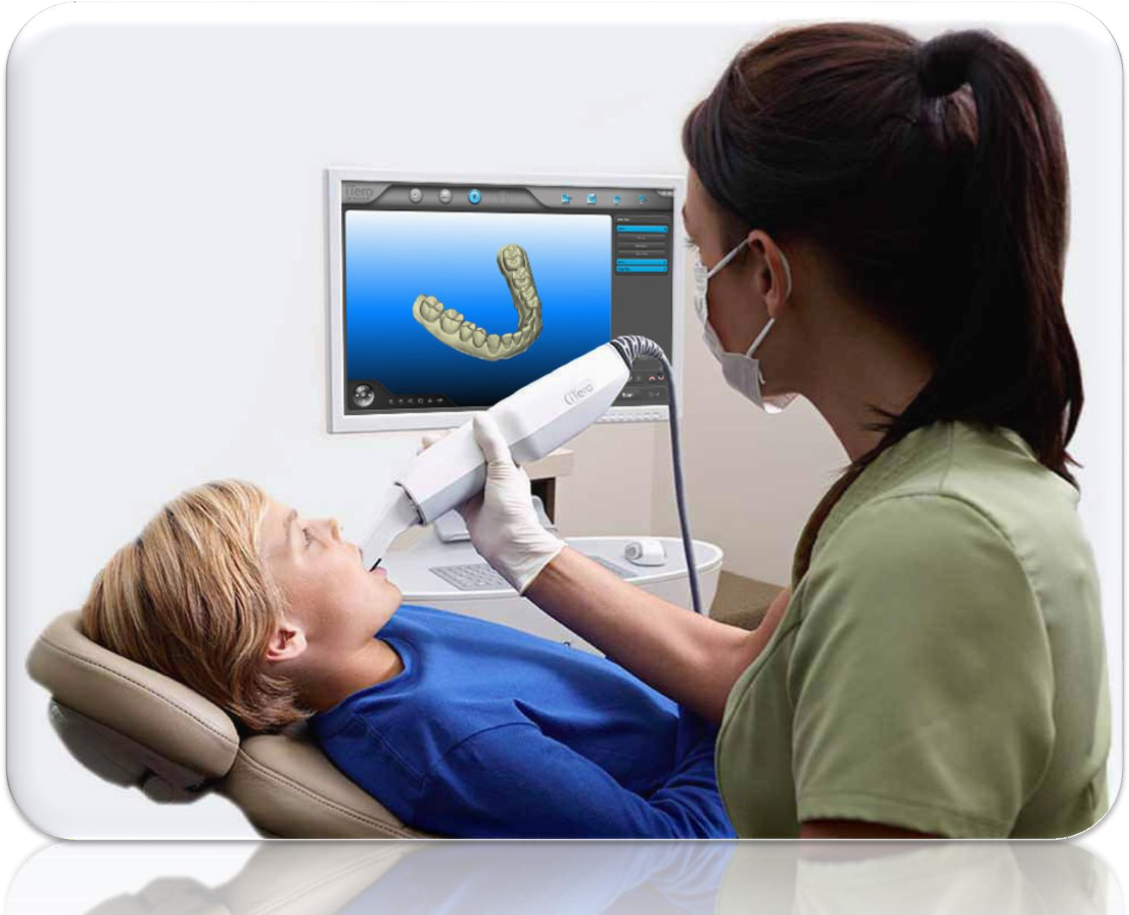
3D Scanner : Screenshot

Slide 11
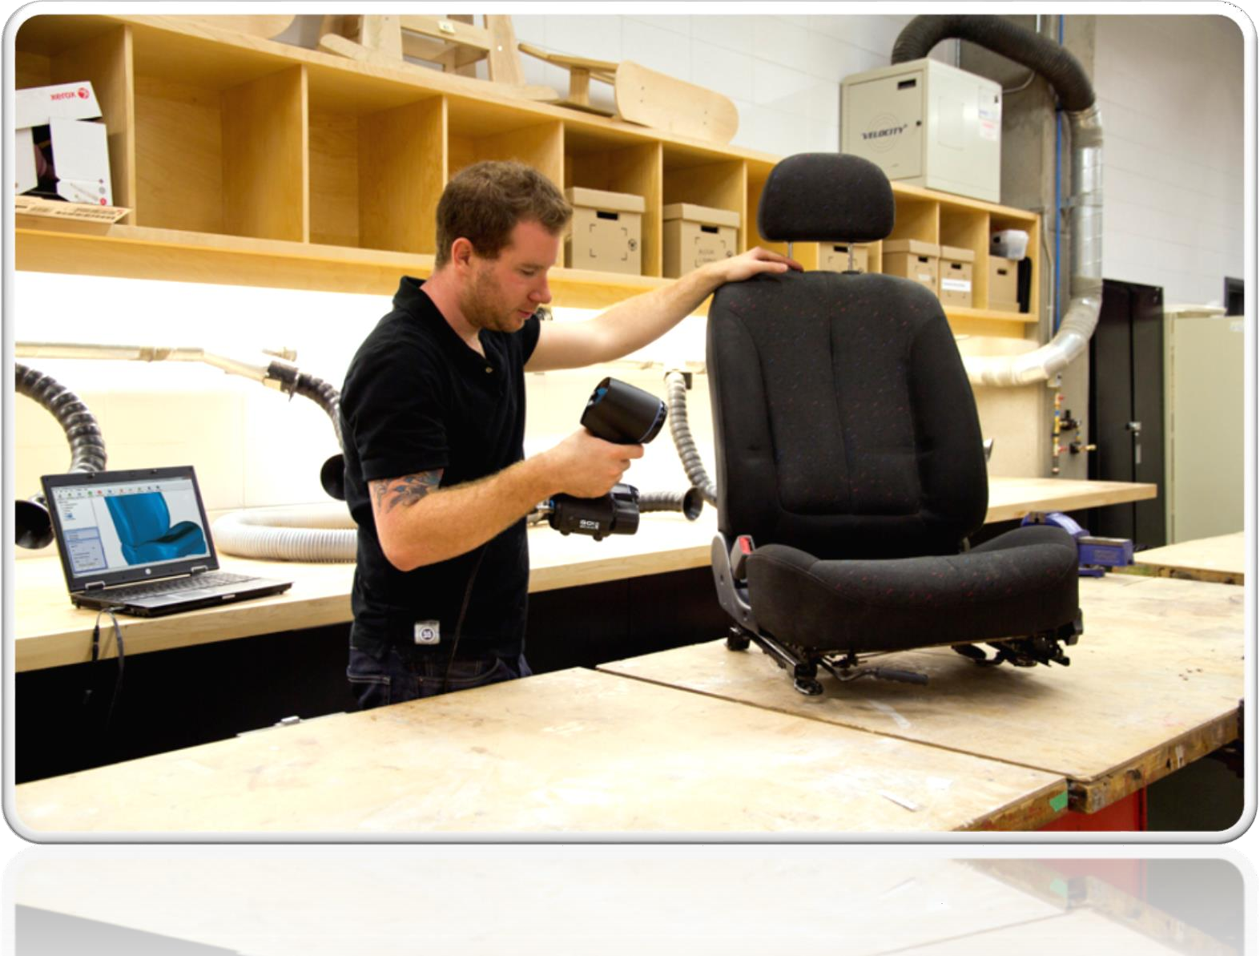
3D Scanner : Screenshot

Slide 12












3D Scanner : Applications
Creating CAD (Computer Aided Design) models of real object
Building (house) modeling
Product quality assurance
In dentistry
In cancer
In gaming

Slide 13
Camera Vs Scanner
Key Point | Camera | Scanner
Dimension | Creates an image from 3D to 2D | Creates an image from 2D to 2D or 3D to 3D
Portability | Portable | Non-portable
Resolution | Higher | Lower
3rd Party software | Not Necessary | Necessary
On system monitor | Available | Not Available

Slide 14

Thank You

